Slide 1
Notes:
Hello Guys , Welcome to the another session of DevOps . In this session I am covering Jenkins server for Continuous Integration. Alright Guys so lets move top our topic which are going to cover today.

Slide 2
Index
Docker Use Scenario
What is Docker
Docker Components
Docker Architecture
Docker Swarm
Docker Compose
Docker Network
Docker Demo
Notes:
AS you can see I am going to discuss about what is continues integration . What is Jenkins . Some use cases with Jenkins and finally a demo. So Guys let start…

Slide 3


Scenario before Docker – The Problem
Lets assume a scenario where a developer wants to develop the application in PHP. So what the environment developer need in order to develop the code ?

Slide 4
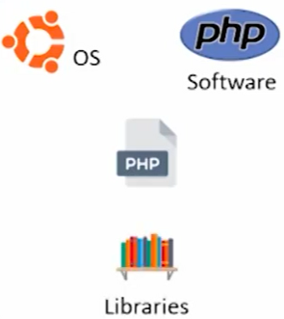
Scenario before Docker – The Developer Environment
The operating System
The Language software like PHP should be installed on OS.
The third party dependencies or library . For e.g. if code need to connect to MySQL then MySQL code library
Developer tune this environment according to their need
Notes:
So before know what is Jenkins , lets understand what is continuous integration .. Sound good guys . Alright… So lets move to next slide

Slide 5
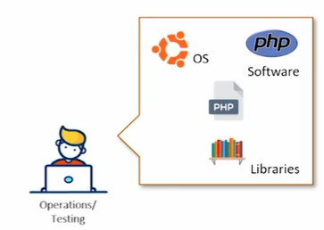
Scenario before Docker – The Tester Environment
Once the Application is ready Developer handover the application for Testing to operation guys .
Noe the operation guys try to replicate the same environment for testing

Slide 6
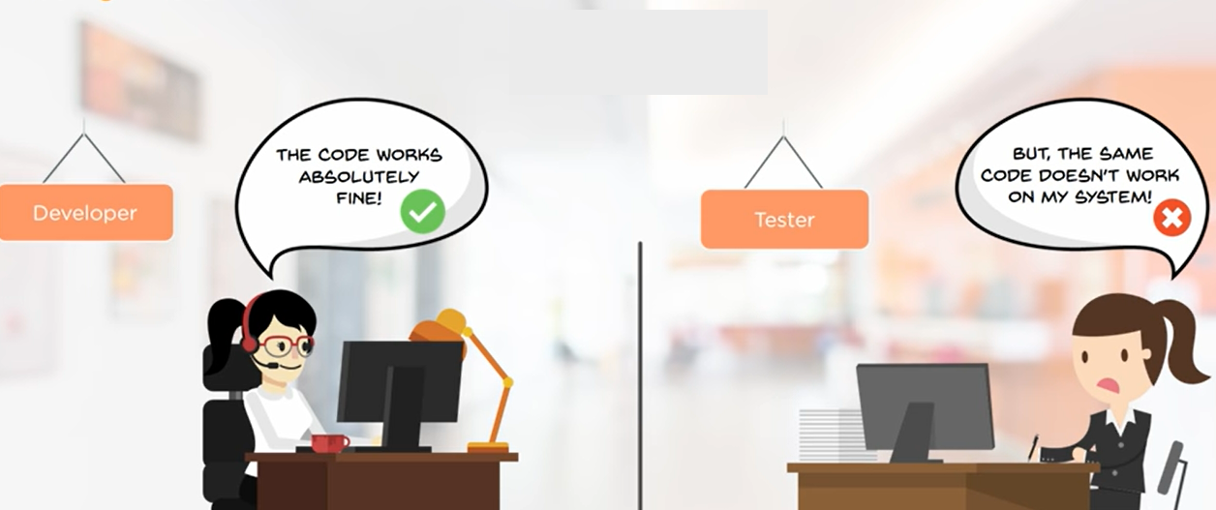
Scenario before Docker – The Testing Fails
The Testing Guys try to fix the environment as per their ability but if the testing fails the blame game start , because developer say it is working on their environment
Notes:
AS you can in slide , we have two scenario ,First one where coding , testing , build and release are manual and second one with tool like Jenkins.
As you can see guys in manual testing the Multiple developers commit the code to central repository like GitHub. The Integration is manual so first all the code need to be fetched , then test and build it . If any bug come it has to be notified. The problem is since all the source code first integrated and then call for testing and if there is any bug come , the complete code need to be check , It is huge time consuming task .
In another scenario as develop 1 commit the code , it has been pulled by continues integration server , which test that price of code and if any bug come it immediately notified to that developer. In this case the developer easly know which code commit has a problem instead of going for complete code of all the developer and also code once tested and build can be deployed immediately instead of waiting for the code of all the developer.
So I hope guys now you understand what is Continuous integration. Now lets under what is Jenkins.

Slide 7
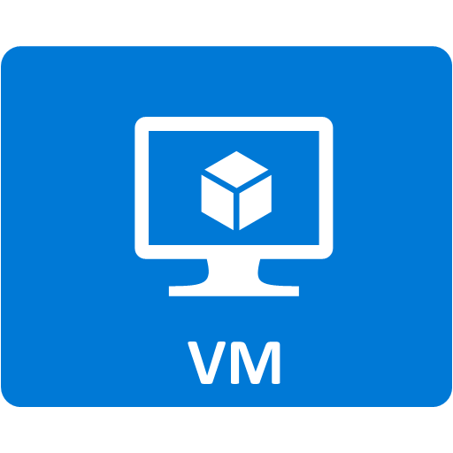
So what the Solutions ?– A Virtual Machine
But the VM is Bulky
For every changes the Developer Make , a new VM may be required
It is complicated process if multiple code is being developed

Slide 8
What we need ?
We basically need an entity which can contain all the software , dependencies and can be ported on the other computer as plug and play
Notes:
So guys as you read from the definition Jenkins is an open source automation tool written in Java. The best part is it has all the different plugin s which can integrated with different DevOps Tool for different development stages. Foer eg it fetches latest source code from git hub , test Continuously with selenium and deploy using Ansible.
So friend now you understand what is Continues Integration and what is Jenkins tool , Lets see some demo.

Slide 9
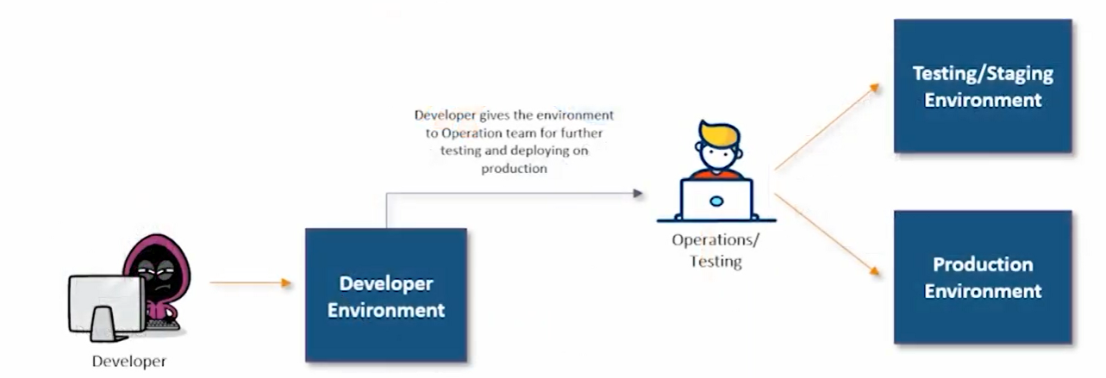
The answer is – A wrapper / A container

Slide 10
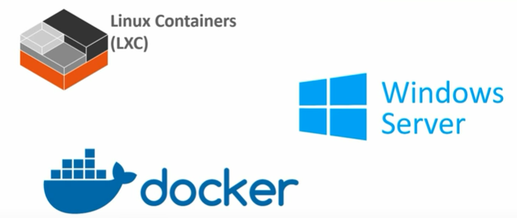
The Popular Container Provider

Slide 11
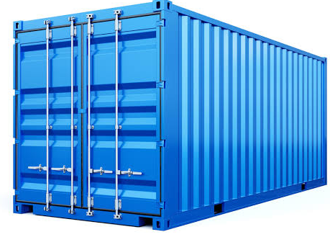
What is Docker
An open platform for developing, shipping, as well as running applications, is what we call Docker. Also, we can say, Docker is a container-management service. It enables us to separate our applications from our infrastructure hence we can deliver software quickly
Virtual
Light weight executable package

Slide 12
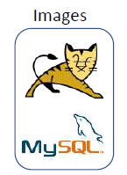
Docker Key Concept
Docker images
A Docker image is a read-only template.
For example, an image could contain an Ubuntu operating system with Apache and your web
application installed.
Images are used to create Docker containers.
ocker provides a simple way to build new images or update existing images, or you can download
Docker images that other people have already created.
Docker images are the build component of Docker.

Slide 13
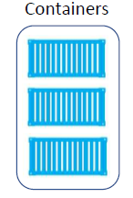
Docker Key Concept
• Docker containers
Docker containers are similar to a directory.
A Docker container holds everything that is needed for an application to run.
Each container is created from a Docker image.
Docker containers can be run, started, stopped, moved, and deleted.
Each container is an isolated and secure application platform.
Docker containers are the run component of Docker.

Slide 14
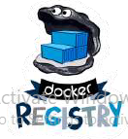
Docker Key Concept
Docker Registries
Docker registries hold images.
These are public or private stores from which you upload or download images.
The public Docker registry is called Docker Hub.
It provides a huge collection of existing images for your use.
These can be images you create yourself or you can use images that others have previously created.
Docker registries are the distribution component of Docker

Slide 15
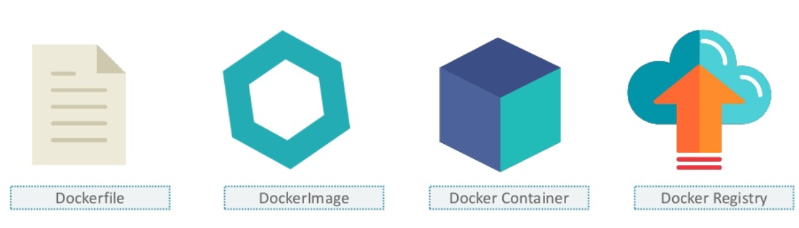
Docker Components

Slide 16

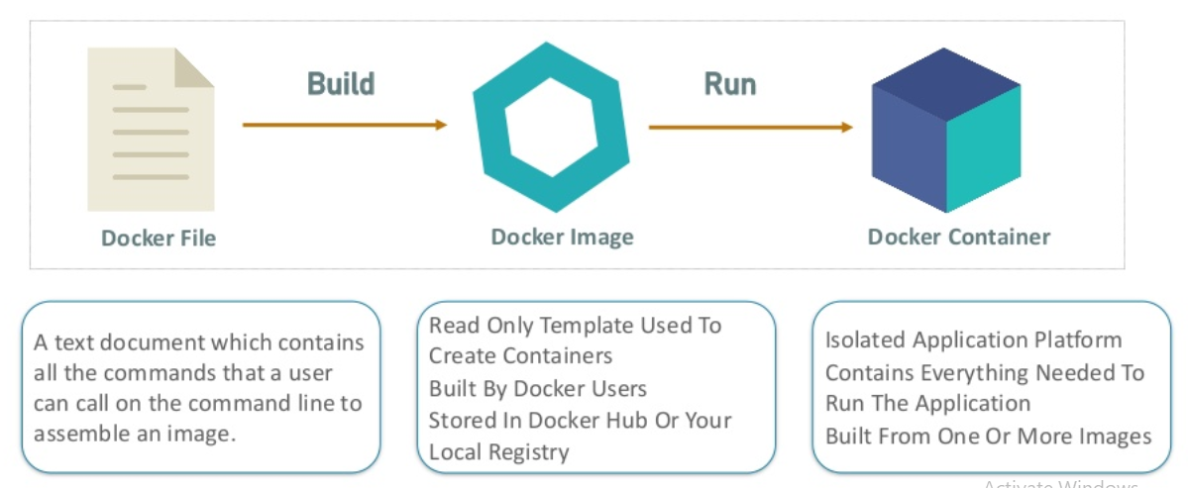
Docker File , Images and Container

Slide 17
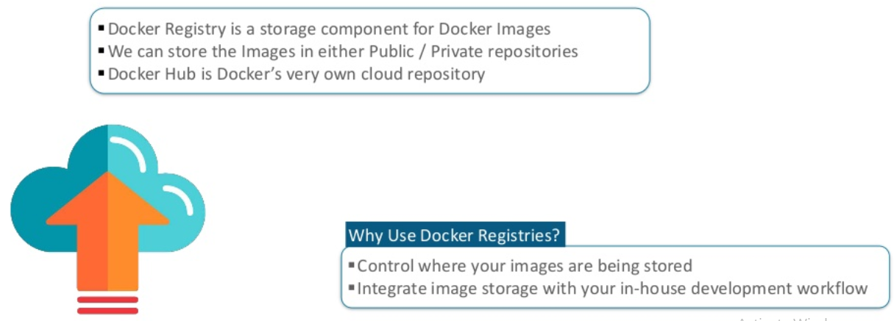
Docker Registry
Notes:
As you can see in the slide , a developer developing code on his local machine , Keep pushing to GitHub, Jenkin pulls the latest version of code and build artifacts . This artifact test using different kind of tools Stylecops+ , Jshint and the output keep publishing on Live server . The result will be published whether the test is successful or not .
Alright Friend now lets see another scenario .

Slide 18
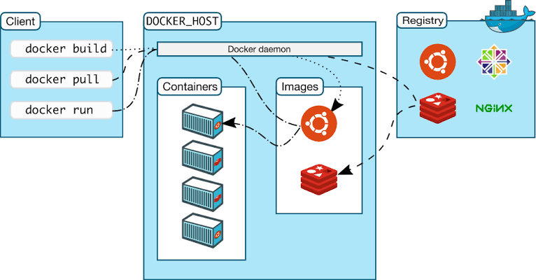
Docker Architecture

Slide 19
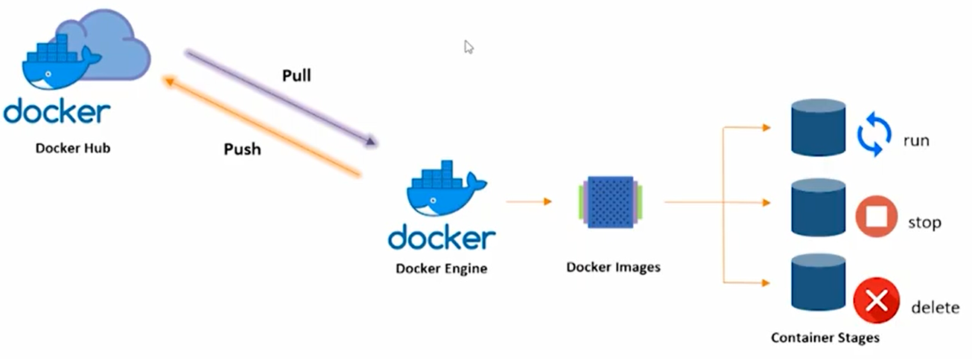
Docker Container Lifecycle

Slide 20
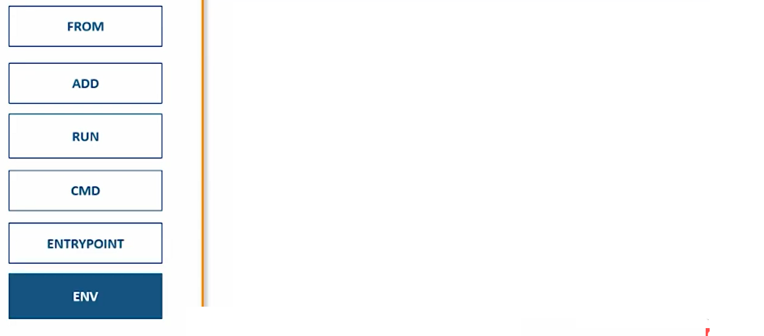
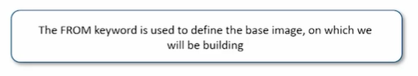
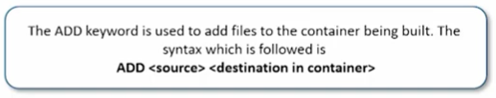
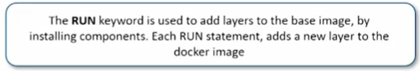
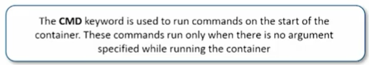
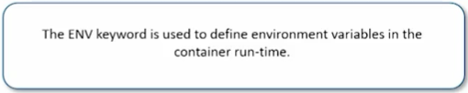
Various Command in Docker File

Slide 21
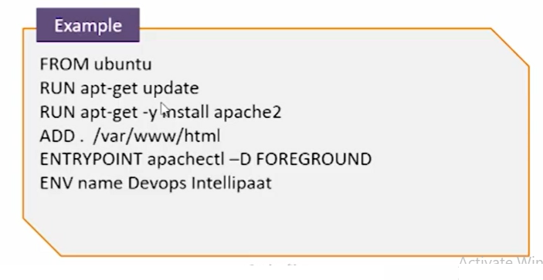
Docker File Example

Slide 22
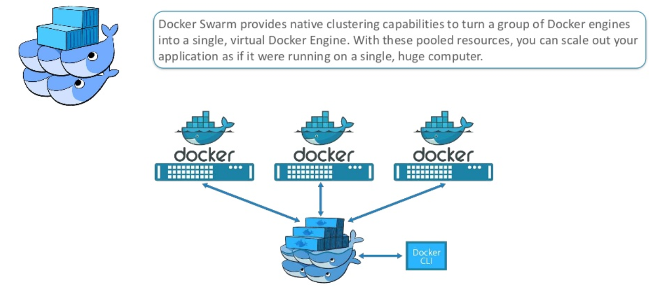
Docker Swarm

Slide 23
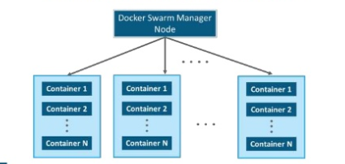
Docker Swarm Manager

Slide 24
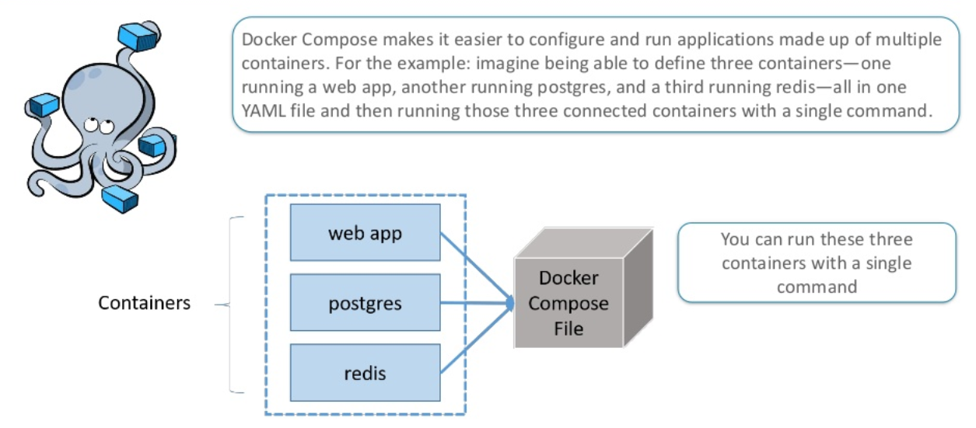
Docker Compose

Slide 25
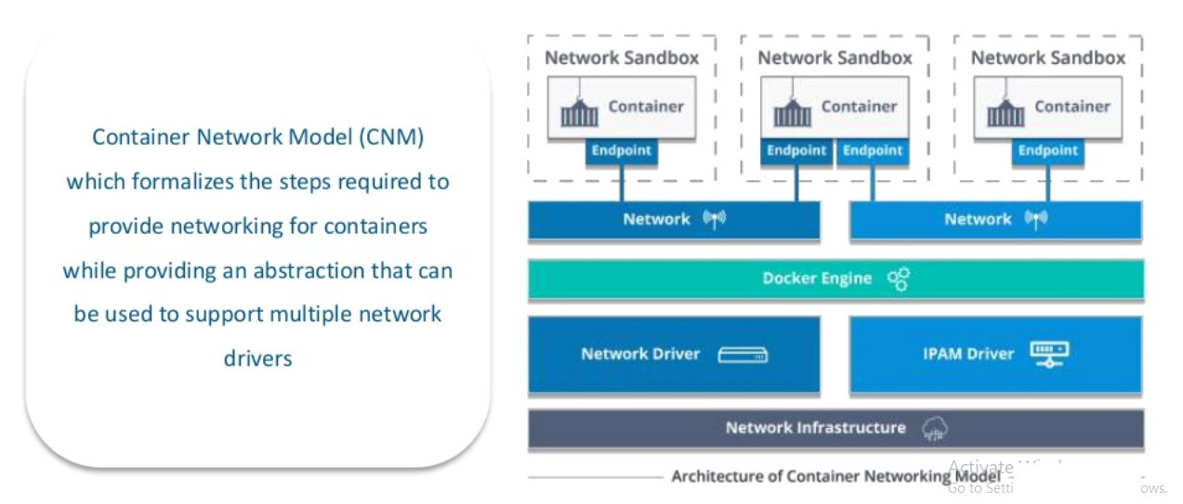
Container Network Model (CNM)

Slide 26
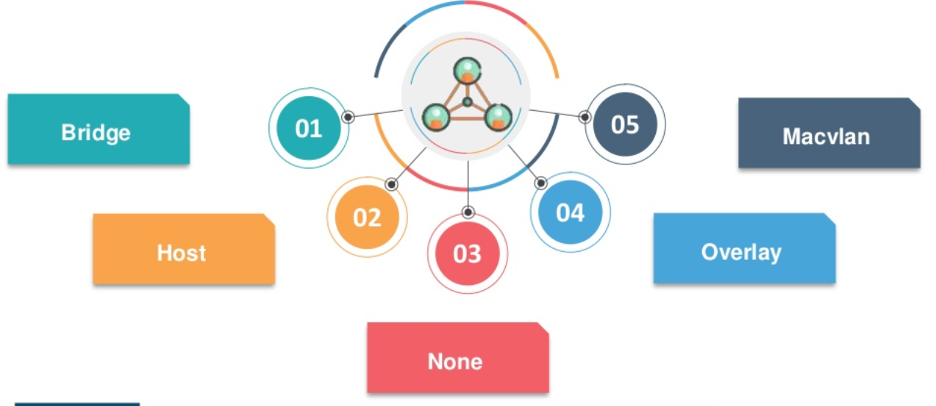
Network Driver

Slide 27
Docker Demo
Notes:
So Guys in this demo we are going to pull a simple java code which print the Hello World from GitHub into Jenkins server , build it using windows command and test it .

